Slide 1
SOUND CHECK

Slide 2
XQS: a native XQuery Schematron implementation
Andrew Sales
Markup UK, 3rd June 2023

Slide 3
Agenda(?)
What it is
Why do it
Design goals
[…]
Notes:
What are we going to cover today?
[…]

Slide 4
About me
Project editor, ISO/IEC 19757-3
Convenor, ISO/IEC JTC 1/SC 34/WG 10
Work at publisher based in London
Notes:
First, a little about me.

Slide 5
About XQS
XQS = XQuery for Schematron
Pronounced /ɛksˈkjuːz/
Written in pure XQuery
BaseX dialect of v3.1
Tested under BaseX 10.x
Notes:
Acronym stands for Xquery for Schematron
But pronounced “excuse”

Slide 6
Why do this?
ISO approved new work to revise standard
Second “reference” implementation
XQuery QLB reserved, but not defined
Rapid development?
Advocacy at meetups
End-user benefits
Notes:
Where did the motivation come from?
ISO approved revision in Sep ’22
No ref impl required by ISO, but having another makes sense, in particular in a different language
Xquery is the obvious choice: query language binding [GLOSS ME] specified but not defined
Hope to learn better what that QLB should look like by doing this!
Appeal of rapid dev – concise & declarative syntax
Have urged community to produce more impls -- time to step up myself
End user: integration into Xquery-based system/workflow

Slide 7
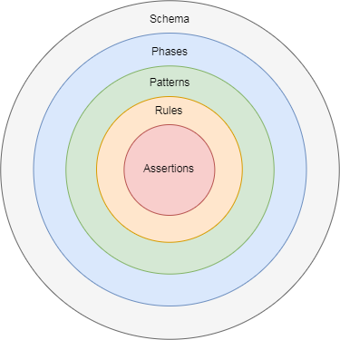
Schematron schema structure
Notes:
Before diving into any detail, an overview of Schematron schema structure:
Phase, pattern, rule, constraints (diagram)

Slide 8
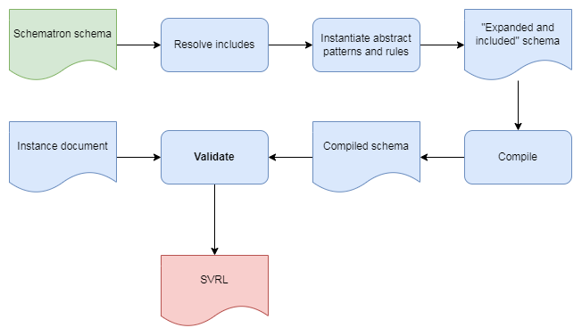
Typical processing
Notes:
this is what the high-level processing model looks like for e.g. XSLT impls
[WALK THROUGH]
Gloss SVRL!!

Slide 9
What design goals?
Conformance over performance
No optimization at this stage
”Dynamic evaluation” of schemas
Portability of “compiled” schemas
(SVRL output)
Notes:
But what are the design goal for THIS impl?
Conformance over performance: this is where the impl is not just native, but naïve Xquery
“Dynamic evaluation” – come back to that in a moment
“Compiled” schemas produced by this software to be portable between engines as far as poss
Although not mandated by the standard, SVRL output

Slide 10
How to do this?
Notes:
Well, like anyone curious about the answer to a question in 2023, I thought I would…

Slide 11
Ask ChatGPT!

Slide 12

Credit: Victor Metelskiy/Shutterstock
Notes:
Thank you for listening ☺

Slide 13
"Implement Schematron in XQuery"
let $schematron := <schema xmlns="http://www.ascc.net/xml/schematron">[...]
let $assertions := $schematron//sch:assert
return (
every $assert in $assertions satisfies (
let $test := $assert/@test
return (
if (exists($assert/@role) and $assert/@role = 'warning') then
count($xml[not($test)]) eq 0
else
exists($xml[$test])
)
)
Notes:
Joking aside: this isn’t a conference about AI, but let’s see what it said.
First question.
(Answer is shortened, for space reasons)
Reasonable attempt – Boolean result, though.
No handling of patterns or rules
Q. Can anyone spot what’s odd here?
A. Pre-ISO namespace!!

Slide 14
“Implement ISO Schematron in XQuery 3.1"
declare namespace sch = "http://purl.oclc.org/dsdl/schematron";
declare function local:schematron($xml as node(), $schematron as node()) as xs:boolean {
let $schematronXSLT := $schematron/sch:schema/xsl:stylesheet
let $assertions := $schematronXSLT/sch:pattern/sch:rule/sch:assert
let $reports := $schematronXSLT/sch:pattern/sch:rule/sch:report
let $transformed := transform(
$xml,
$schematronXSLT,
map { 'validation-mode': 'lax' }
)
[...]
Notes:
So I asked specifically for ISO SCH and XQY 3.1, to see if that made a difference.
This time, it proudly declares the ISO namespace (see top).
BUT it uses the XSLT impl!

Slide 15
"Implement natively [etc.]"
declare namespace sch = "http://purl.oclc.org/dsdl/schematron";
let $assertions := $schematron//sch:assert
return (
every $assert in $assertions satisfies (
let $test := $assert/@test
return (
if (exists($assert/@role) and $assert/@role = 'warning') then
count($xml[not($test)]) eq 0
else
exists($xml[$test])
)
)
Notes:
Same approach as at first, but in ISO namespace…

Slide 16
“Now include an SVRL report"
for $assert in $assertions return
if (exists($assert/@role) and $assert/@role = 'warning') then
if (count($xml[not($assert/@test)]) eq 0) then ()
else
<svrl:failed-assert test="{$assert/@test}" role="warning">
<svrl:text>{data($assert)}</svrl:text>
</svrl:failed-assert>
else
if (exists($xml[$assert/@test])) then ()
else
<svrl:failed-assert test="{$assert/@test}">
<svrl:text>{data($assert)}</svrl:text>
</svrl:failed-assert>
Notes:
Now SVRL appears, but still no pattern/rule handling, so no complete SVRL output.

Slide 17
Did asking ChatGPT help?
ISO
Native XQuery
SVRL
Notes:
The quality of the questions I asked ChatGPT probably didn’t help.
Reason I did this and shared it here is it helped clarify the goals a bit.

Slide 18
Design decisions
Schema expects single document
Rule context must be a node(s)
Evaluated against document root
XSLT: <sch:rule context="*">
XQS: <sch:rule context="//*">
Notes:
With this new QLB, we have to make some decisions about things like evaluation context, i.e. what is the input to the schema and its rules etc?
XQY allows us to address multiple docs, but standard and other bindings speak of one, so going with that strict interpretation
Rule context (what selects items to be tested) must be a node
This expression will be evaluated in context of document root
Implication for schema authors used to XSLT impls is that a path like the one shown will only match the root element!!

Slide 19
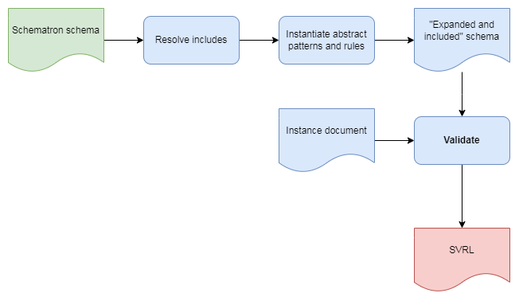
Dynamic evaluation
Notes:
So to return to the goal of dynamic evaluation I mentioned earlier.
This is what that looks like.
Pre-processing steps still in place, but no compilation step
Q. Why? A. no absolute need for compile step, so curious what it would throw up doing it this way; also: previous experience of XMLProbe/Probatron (XPath impl)

Slide 20
Evaluate schema
Assemble prolog of validation context:
Namespaces
Local variables
User-defined functions
Invoke xquery:eval(), passing:
Global variables, as external variables
Instance document, as map{"":doc(…)}
Notes:
In the evaluation portion, we first:
Build prolog of nss, local vars and UDFs
Pass to BaseX-specific xquery:eval() function, with map of global variable bindings and the instance document itself (key is empty string)

Slide 21
Pattern variables
Local scope
Evaluated against document root
Entail updating bindings per pattern
XSLT impls make scope global
Notes:
Patterns are essentially a grouping mechanism for rules.
contain variables unusual because local in scope to the containing pattern, but are evaluated in the context of the instance document root
change in scope but not context means the map of bindings must be updated for every pattern
This means XQS implements pattern variables as local, which behaviour differs from that of the XSLT implementations.

Slide 22
documents attribute
Validate “subordinate” documents:
<sch:pattern documents="/element/@secondary">
<sch:rule context="/">
<sch:report test="root"/>
</sch:rule>
</sch:pattern>
Notes:
Another feature of patterns, introduced in 2016 edition of standard.
Allows other, “subordinate” documents to be validated
Here, path in bold evaluated against document root
Documents at resulting URIs are accessed
Rules applied to them

Slide 23
documents attribute underspecified?
Rules apply to instance document as well? Presumably not.
Are pattern variables in scope? e.g.
<pattern
documents=‘/other/docs[not(@path = $these)]’>
<let name=‘these’ value=‘not-me.xml’/>...
XQS assumes so.

Slide 24
Rules as if-then-else
declare function eval:rules($rules as element(sch:rule)*, $prolog as xs:string?, $context as map(*)) as element()*
{
if(empty($rules))
then ()
else
let $result := eval:rule(head($rules), $prolog, $context)
return if($result)
then $result
else eval:rules(tail($rules), $prolog, $context)
};
Notes:
Rules in SCH are supposed to behave like an if/then/else statement.
i.e. if a rule context matches (“fires”), no further rules in that pattern are processed
XQS implements this as tail recursion.
Here, the call to eval:rule() returns some SVRL, or the empty sequence if there is no match.

Slide 25
Hidden syntax errors
Analogous to interpreted languages:
<sch:rule context="/..">
<sch:report test="???">[...]</sch:report>
</sch:rule>
Remedy: xquery:parse()
Notes:
One side-effect of this dynamic evaluation approach is that syntax errors can lurk in a branch of code never reached, cf. interpreted languages like Python.
Here, the faulty XPath will only be seen and detected by the processor if the rule context matches.
One remedy is to parse expressions ahead of time, using BaseX’s xquery:parse(), which throws an error on invalid XQuery.

Slide 26
Global read lock
xquery:eval() imposes this
No issue if not using BaseX as DB
Otherwise: use compiled schema instead

Slide 27
Compile schema
Tangible code that can be debugged
Function for each pattern, rule, assertion
Output is XQuery main module
Document or URI as external variable
Runs under BaseX and Saxon (et al.?)
Notes:
Pros and cons of developing this way
Actual code you can look at and debug
A bit meta, though: e.g. if/then/else statement writing an if/then/else…
Produces XQY main module
Runnable under Saxon (at least) too

Slide 28
Compile complications
Assembled XQuery contains (SVRL) nodes and strings
=> serialize(map{‘method’:’basex’})
Internal variables in XQS namespace
Currently compiles per phase
Notes:
The output from compiling consists of both nodes (SVRL elements) and strings.
So simplest was to pass these as a sequence to serialize, with the custom basex method.
Also, note that the application generates variables for internal use in the XQS namespace.
SO: users should avoid declaring that namespace in their Schematron schema. Bad things could happen if not…
Currently, compilation takes place based on the active phase – need to change that, so compile once and pass phase in at validation-time.

Slide 29
Other features
User-defined functions:
<function xmlns='http://www.w3.org/2012/xquery’> declare function myfunc:test($arg as xs:string) as xs:string{$arg};</function>
Maps as variables:
<sch:let name='foo' value="map{'foo':'bar'}}" as='map(*)'/>
Notes:
1. UDFs: place before patterns, in XQY namespace
2. Maps can be declared as variables currently – require use of @as (argument here for including this in standard, on element let)
3. Assignment of arrays & anon functions to variables to come

Slide 30
Caveats
Expansion & inclusion deferred
BUT dynamic evaluation as well as compilation
Reliant on BaseX
BUT compiled schemas (should be) portable
No need to store documents in BaseX
Notes:
Also a few caveats about XQS:
No expansion/inclusion: deferred for now – still needs doing, but a known quantity; more interest lies in implementing the actual validation logic
So that’s where I’ve focused my efforts
As a trade-off, if you like, there are 2 methods of validating: dynamic & compiled
BaseX required to run the tool, BUT compiled schemas should be portable: they are generic Xquery
And no need to store your documents there – you can just use it as a validation tool

Slide 31
Lessons learned
Start with compiling
More work to maintain two methods and keep in sync
Unit tests essentially the same for both
Never try to write a paper at the same time as helping to organise a conference…
Notes:
Starting with the compilation approach would have been easier
Two methods is more work
Bonus that once evaluation method was written, just change function name in unit tests to get most of suite without further effort

Slide 32
Learnings for XQuery QLB?
Multiple docs as input?
Specification of rule context
Typed variables, generally
User-defined functions
Maps, arrays, anon functions as variables

Slide 33
Status
Pre-release
More info on plans in paper
Issues in GitHub repo too

Slide 34
Questions?
github.com/AndrewSales/XQS

